Slide 2
Cognitive Function among cART-treated Children and Adolescents with HIV in Zambia: Results from the HIV-associated Neurocognitive Disorders in Zambia (HANDZ) study
Sylvia Mwanza-Kabaghe, PhD reporting for the HANDZ study team
University of Zambia /Paediatric HIV Center of Excellence

Slide 3
Studies have demonstrated that children with Human Immunodeficiency Virus (HIV) are at increased risk for developmental delay and cognitive impairment.
Prior studies have been limited by including a mix of treated and untreated subjects focusing on a restricted age range, and by failure to include an appropriate control group.
As part of the ongoing HIV-Associated Neurocognitive Disorders in Zambia (HANDZ) study, we sought to evaluate cognitive function in virally suppressed cART-treated children and adolescents living with HIV compared to demographically matched HIV-exposed uninfected controls.

Slide 4
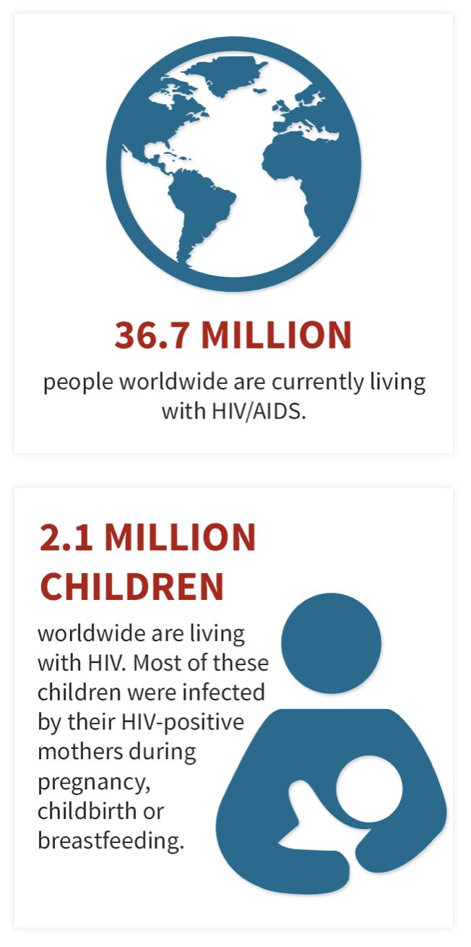
Why talk about HIV and Cognition in Zambia?
More than 90% of children with HIV live in Sub-Saharan Africa
Neurologic complications are much more common in resource-limited settings
Neurologic complications are potentially preventable and treatable

Slide 5
Changing paradigm
1981-1994 – CNS Opportunistic infections common
1995-2006 - HAART introduced, fewer CNS complications
2007-present –Chronic cognitive complications of HIV more common
‘’The most severe HAND diagnosis (HIV dementia) was rare, but milder forms of impairment remained common, even among those receiving CART’’ - CHARTER 2010

Slide 6
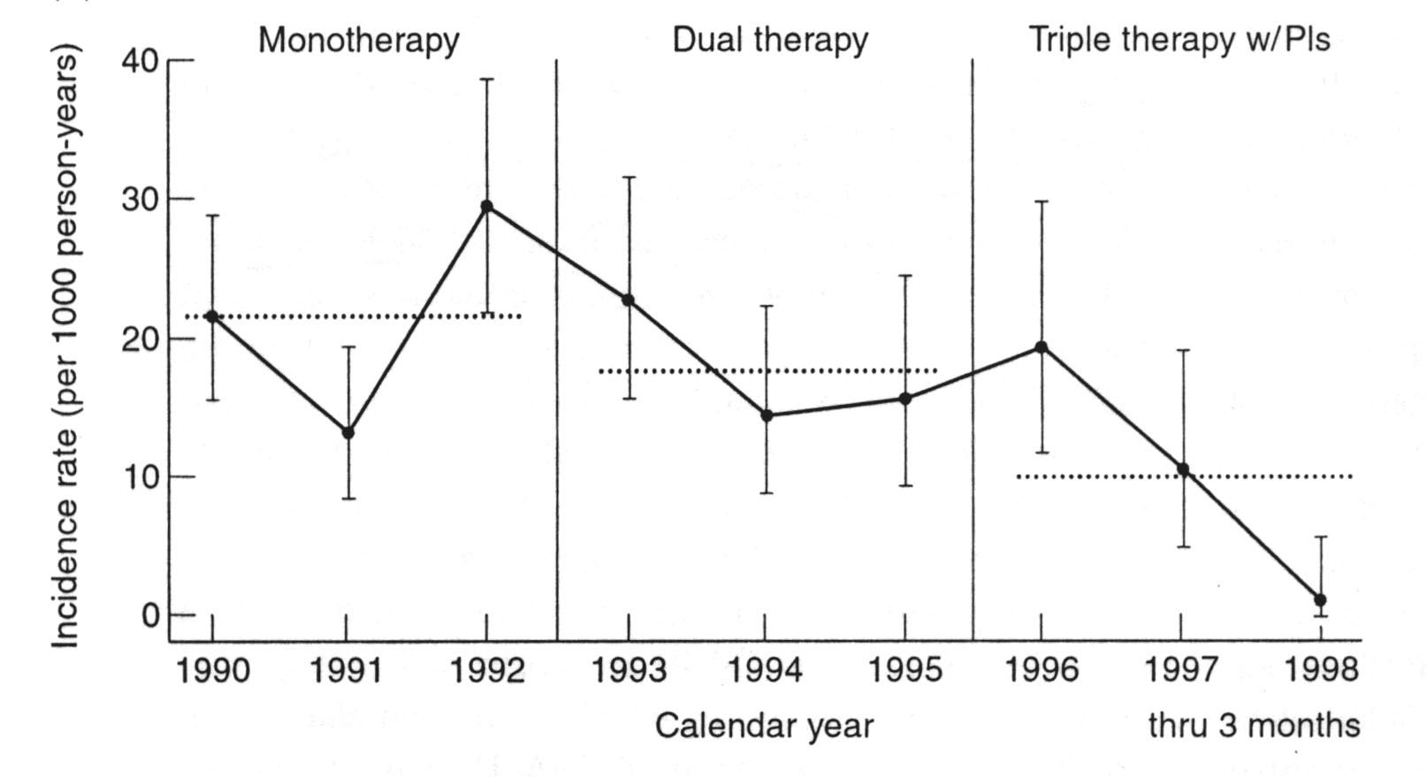
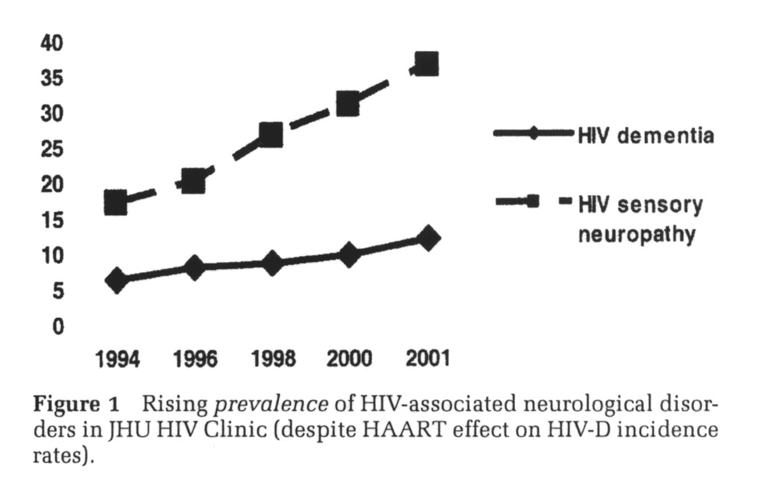
Declining Incidence with increasing prevalence of chronic neurologic complications of HIV due to longer survival
(cART)
Incidence of HIV Dementia
HIV-associated neuropathy
Prevalence of HIV-associated
neuropathy and HAND
Prevalence
HIV-Associated Neurocognitive Disorders
Sacktor et al, 2002
Notes:
Although the rates of severe HIV dementia has gone down, as patients are surviving longer, the prevalence of HIV-associated neurocognitive disorders is increasing.

Slide 7
Questions
What is the effect of HIV on cognitive function in stable, cART-treated children and adolescents?
What are the risk factors for cognitive impairment in children and adolescents with HIV?

Slide 8
HANDZ Cross-Sectional Design
Total population (n=400)
200 subjects with HIV
Subjects with impairment (Cases)
Subjects without impairment (Controls)
200 HEU Controls
HEU Controls

Slide 9
Inclusion/Exclusion Criteria
Inclusion: Ages 8-17, at least one living parent, patients with HIV must have been on cART for at least one year prior to enrollment
Exclusion criteria: History of CNS infection, pregnancy, epilepsy, chronic kidney or liver disease

Slide 10
METHOD | CROSS SECTIONAL STUDY
Sample | Outpatient children with HIV on cART and no history of CNS opportunistic infection and HIV-exposed uninfected controls
Sampling procedure | Stratified sampling to include equal numbers of children in each age bracket from 8-17 ( 20 from each age group by gender 10/10)
Instruments | Standardized questionnaire to assess demographics, clinical history, adverse childhood events, and socioeconomic status, Cognitive functioning tests.

Slide 11
Cognitive domain Tested | Neuropsychological Test
Learning/Immediate Recall | CVLT-C List A Total Trials 1-5; NT Auditory verbal learning test; UNIT-2 Spatial Memory
Processing Speed: | Pattern Comparison; NT Oral Symbol Digits; Trail Making Test (TMT) Condition 1
Motor Speed | Gait; 9-hole peg test; TMT Condition 5
Verbal fluency | NEPSY-2 Word generation
Non-verbal intelligence | Universal Non-Verbal Intelligent Test Second Edition (UNIT-2 ) Two-subtest IQ score (Non symbolic quantity + Analogic Reasoning).
Memory | CVLT-C Delayed Recall
Attention/Working Memory | Digit Span total score; NT List Sorting Working Memory; CVLT-C Trial 1; TMT Condition 1-Visual Scanning Omission errors.
Executive Function – Inhibition | NT Flanker; Pencil Tapping; TMT Condition 1-Visual Scanning Commission errors.
Executive Function – Set Shifting / Cognitive Flexibility | Wisconsin Card Sorting Test-Perseverative Errors Dimensional Change Card sorting Test (DCCS)

Slide 12
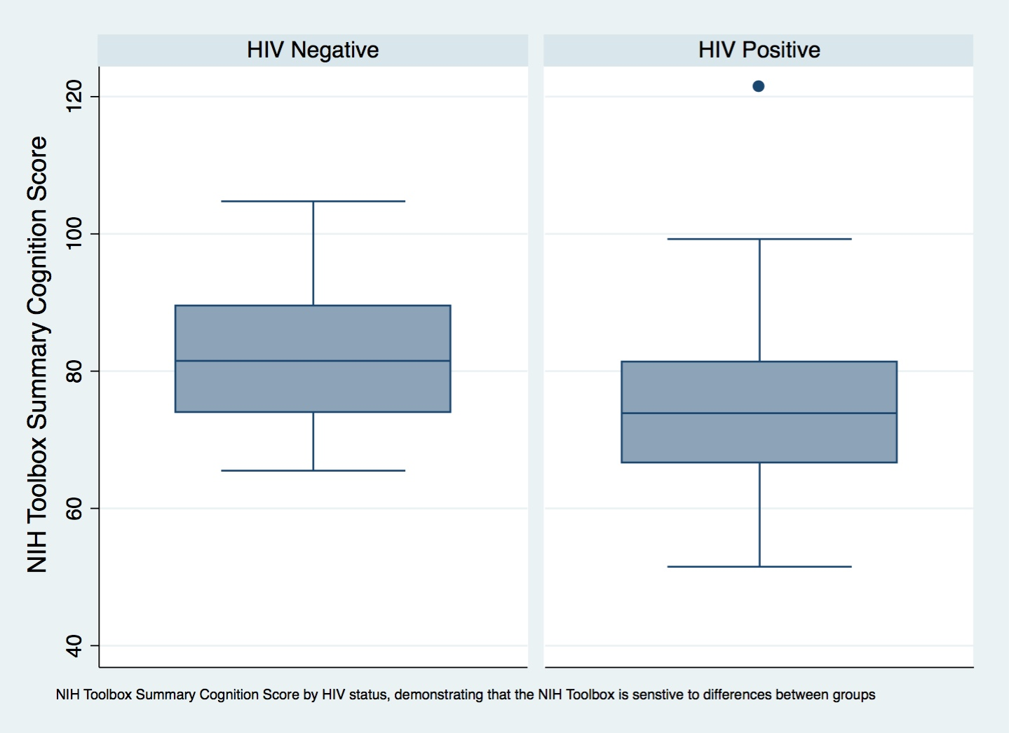
Results Children with HIV performed significantly worse on a summary score of cognition

Slide 13
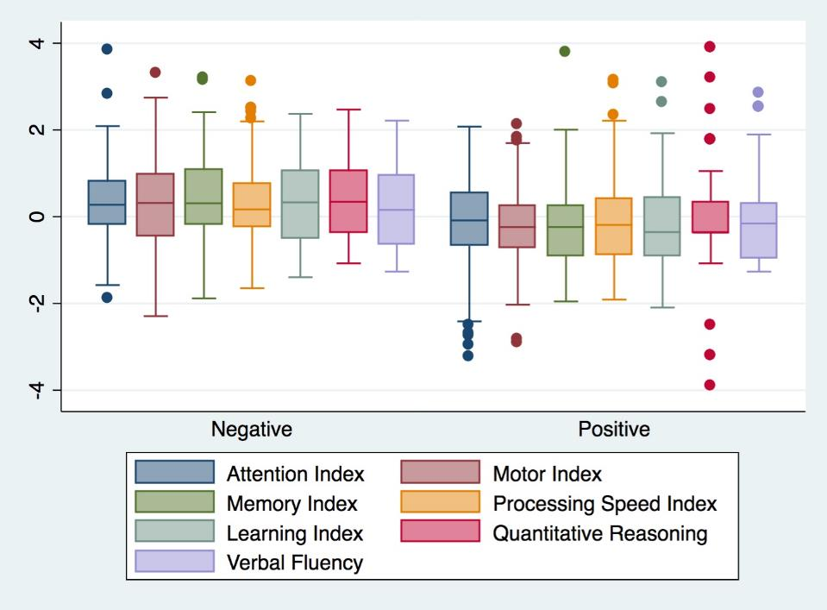

Slide 14
What cognitive domains are most affected?
Attention
Working memory
Processing speed
Psychomotor Speed

Slide 15
Risk factors for cognitive impairment
 | Impaired (n=63) | Unimpaired (n=91) | Odds Ratio | P-value
Low SES | 30% | 14% | 2.7 | 0.01
Low maternal education | 78% | 45% | 4.3 | <0.001
Depression | 17% | 7% | 3.1 | 0.03
CD4 nadir<200 | 15% | 6% | 2.5 | 0.09
WHO Stage 4 | 54% | 45% | 1.5 | 0.25

Slide 16
Overall, mild correlation between SESI and Cognition (Spearman's rho = 0.19, p=0.01)

Slide 17
However, this is driven almost entirely by strong correlation among children with HIV
HIV Negative
Rho=0.1, p=0.5
HIV Positive
Rho=0.3, p=0.001

Slide 18
What is the mechanism for poor cognitive performance in low SES children with HIV?
Patients with lower SES had:
Later initiation of cART
Poorer adherence to cART
Increased rates of malnutrition
Decreased educational opportunities

Slide 19
Both SES and HIV affect cognitive function
However, SES has a much stronger correlation with cognition in children with HIV
Children with HIV and low SES may be uniquely vulnerable to cognitive complications of HIV
Patients with HIV and low SES more likely to “fall through the cracks” in the treatment cascade

Slide 20
Implications for future research
We are getting better at predicting the present—can we predict the future?
Next steps in the HANDZ study are to look at longitudinal outcomes
Trials of interventions to improve development and cognitive function in children with HIV could potentially target SES-specific risk factors

Slide 21
Acknowledgements and Disclosures
Research reported in this presentation was supported by the National Institute Of Neurological Disorders And Stroke of the National Institutes of Health under Award Number R01NS094037. The content is solely the responsibility of the authors and does not necessarily represent the official views of the National Institutes of Health.
Research discussed in this talk was supported by grants from the Center for AIDS Research (CFAR), an NIH-funded program (P30 AI 045008).

Slide 22
Thank you

